Slide 1
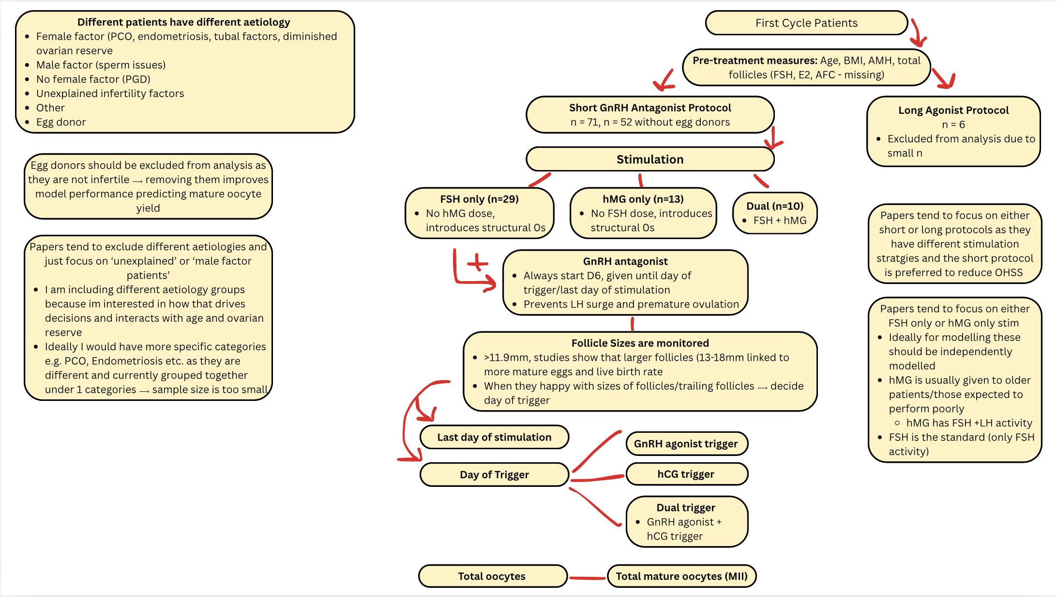

Slide 2
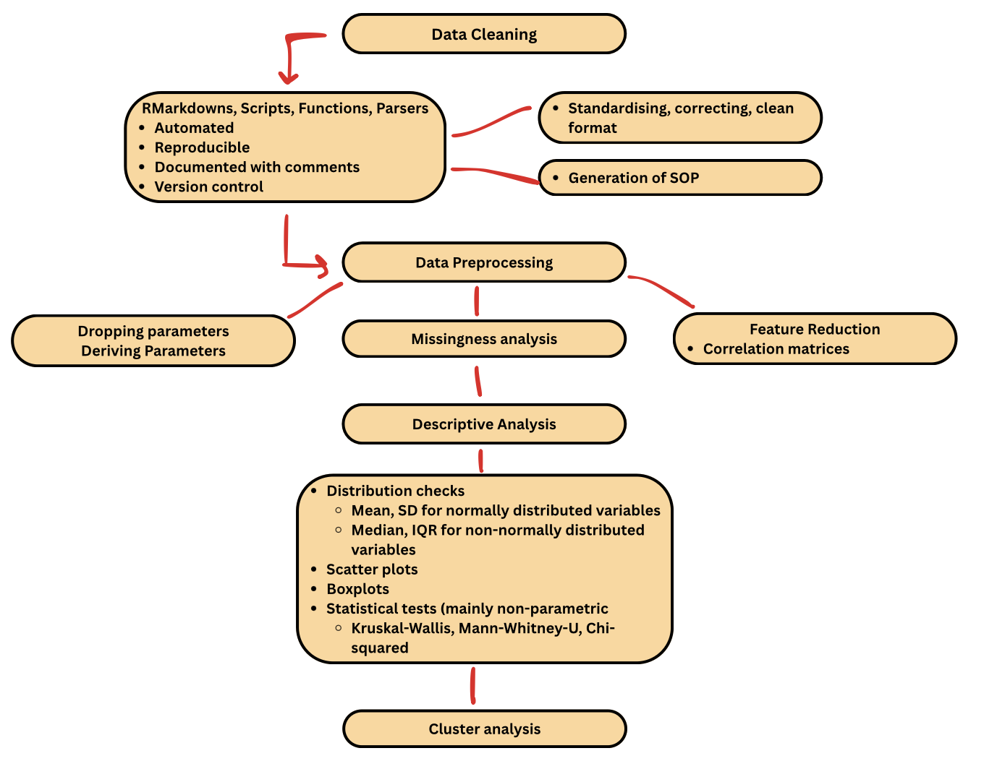

Slide 3
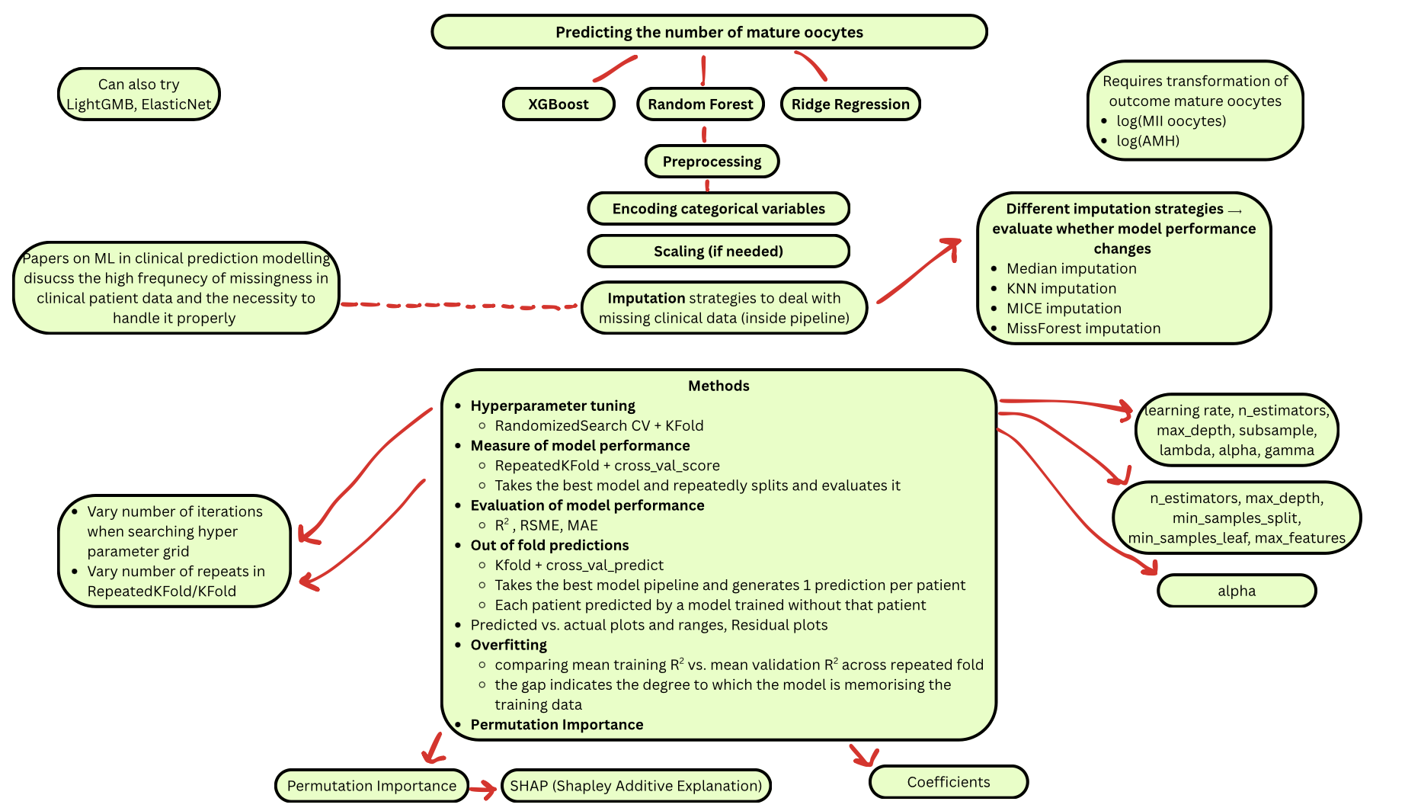

Slide 4
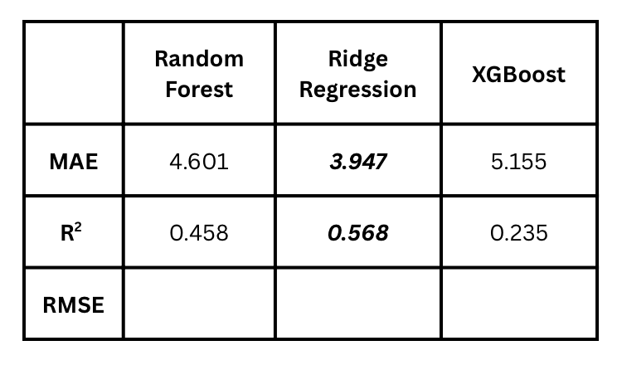


Predicting the number of mature oocytes from baseline data
Ridge regression highest R², lowest MAE, least overfitting
XGBoost overfitting more than Random Forest, largest gap between training and validation R²
All models consistently struggle with higher mature oocyte predictions (similar to other papers)
XGBoost predicts up to slightly higher mature oocytes than Random Forest
Currently working on SVM and LightGBM model

Slide 5
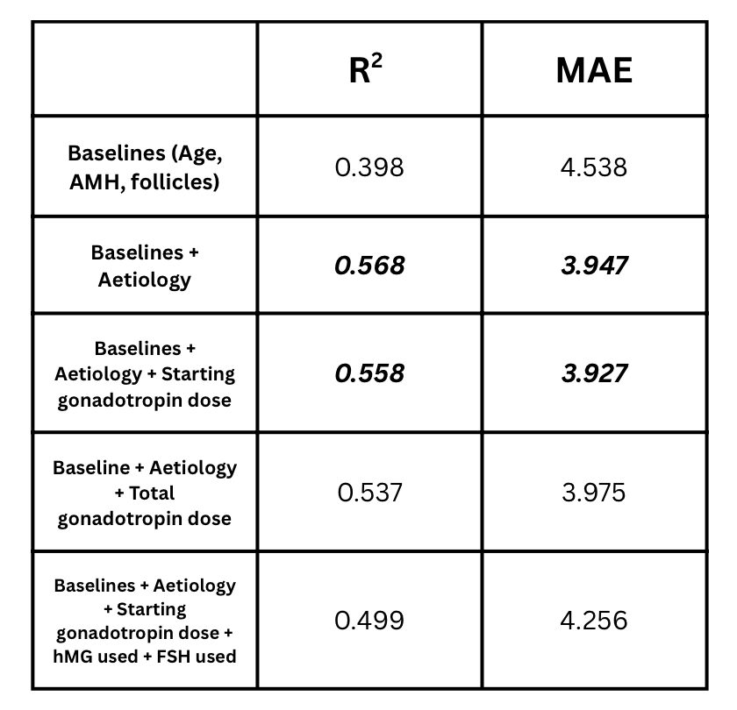
Ridge Regression Models
Models struggle to predict higher bound of mature oocytes → the better models predict these best
Because they are extremes
Because there is not enough data?
These patients have responded adequately but should be flagged for OHSS risk
Moderate – mild overfitting in all models
Removing age from baselines reduces overfitting → AMH / baseline follicles are reflecting the ovarian reserve information more than age
Adding dosing does not improve the model

Slide 6
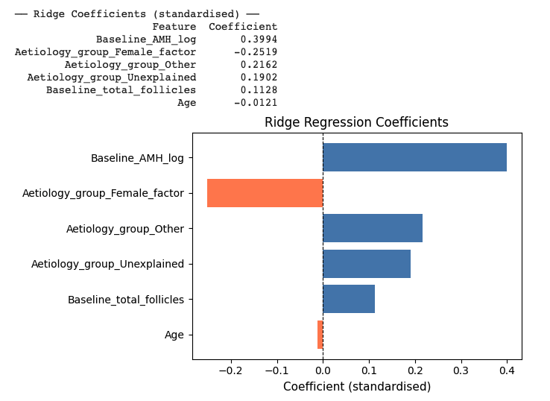
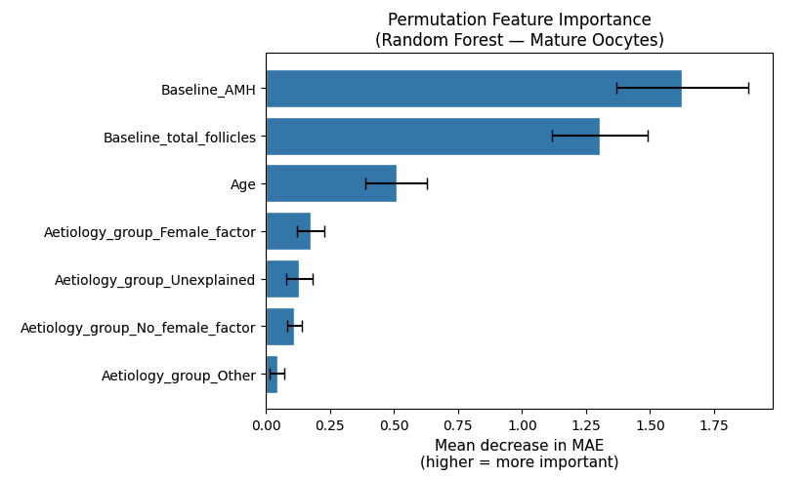
AMH is the dominant predictor
Patients with female factor infertility yield fewer oocytes than patients with no female factors even after adjusting for AMH and follicles
Similar to unexplained infertility patients and other (note: other is a small sample size)

Slide 7
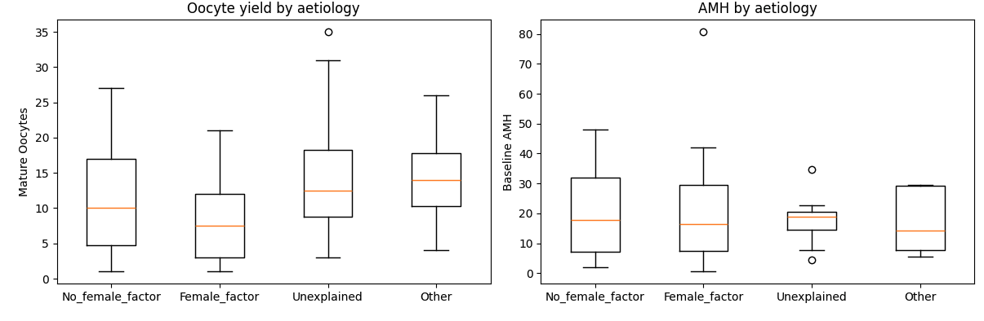
Looking at female factor patients
Produce the least amount of mature oocytes
But AMH distributions show some similarity between groups
Notes:
Further explore with a partial dependence plot? Adjusted residual plot? – After accounting for ovarian reserve (AMH/baseline follicles) which aetiology groups do better/worse than expected?

Slide 8
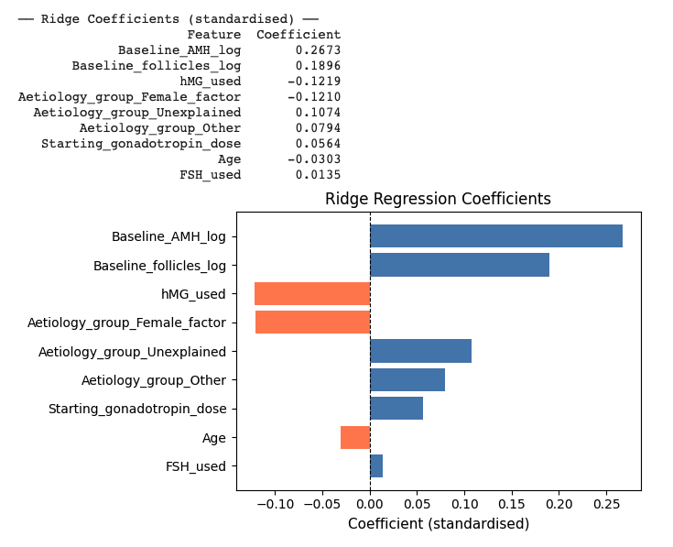
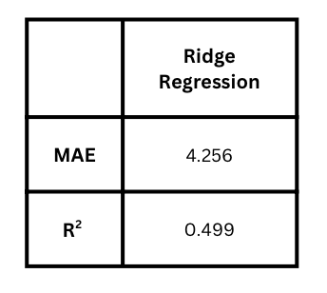
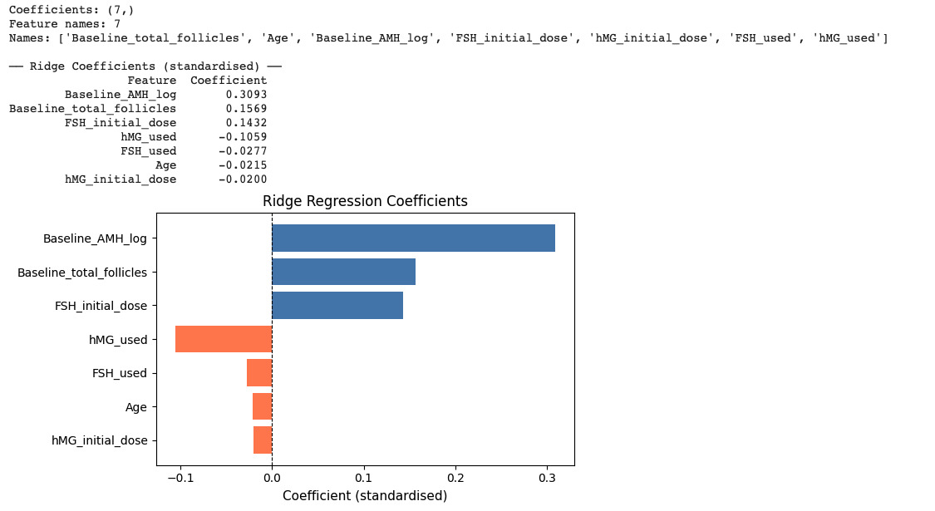

Outcome of baseline + protocol modelling
Baseline predictors consistent with the best baseline only model
Female factor still negative
FSH initial dose is positive
hMG initial is negative
Total starting gonadotropin dose is positive
Confounding
Notes:
Baseline predictors are consistent with the best baseline only predictor model
Baseline AMH log strongest overall predictor, dominant signal confirmed across all models
Baseline total follicles second strongest predictor
Female factor patients still negative and strong predictor
FSH initial dose is positive --> higher FSH dose associated with more oocytes
Possible interpretation
Higher FSH dose --> stronger stim --> more mature oocytes
Confounding by indication = clinician anticipates good responder --> prescribes standard/higher dose
High dose and high yield = good reserve
FSH only patients do have higher AMH --> but the positive effect persists after AMH and follicles are controlled for, so is there a possible independent contribution?
hMG used/initial dose = negative coefficient --> patients who receive hMG produce fewer mature oocytes than those who do not
hMG typically given to poor responders so even after adjusting for AMH and total follicles there may be residual confounding indication effect
FSH used, seems to add nothing

Slide 9
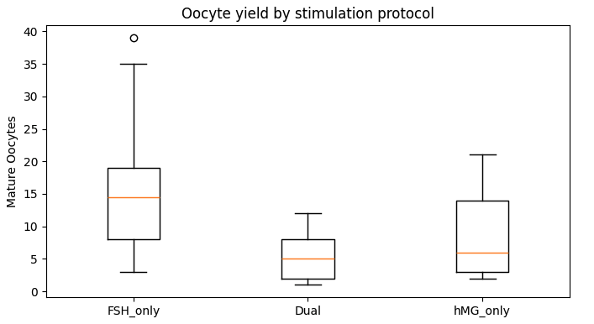
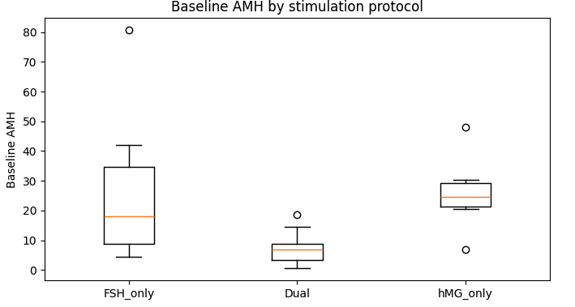
Mature Oocytes
FSH only stimulated patients have the highest median oocytes, much greater spread compared to hMG only/dual
FSH is likely not more superior than the other protocols at yielding more oocytes
FSH only is likely selected and given to patients who are expected to be ‘normal’ responders
hMG/dual stim are likely given to patients who are poorer responders (literature supports hMG being given to older patients)
AMH
FSH widest spread of AMH → seems to be the default protocol
Therefore, FSH stimulation strategy (starting doses, total doses, dose changes) should ideally be modelled alone but not currently possible due to small
Interesting = hMG only group have high AMH
Dual has the lowest AMH likely representing the low responders

Slide 10
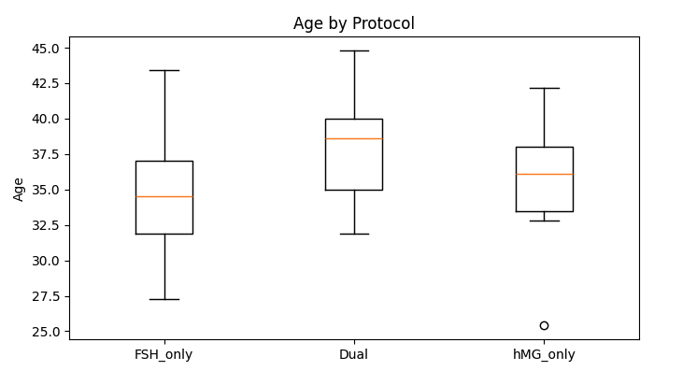
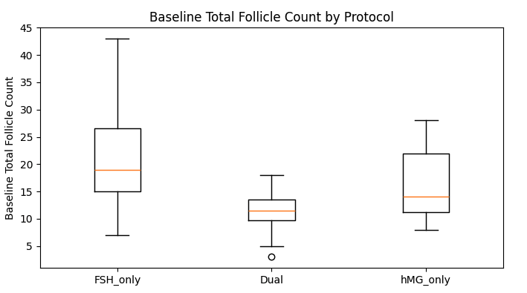
Age
Dual and hMG only patients have older median ages
FSH wide range of ages
A lot of overlap of ages
Perhaps aetiology also comes into play?
Baseline total follicles
FSH only patients have higher baseline follicles
Exploring patients on 2nd, 3rd , 4th, cycle → a lot seem to be on dual stim
→ Only have ~ 11 patients with further cycle data
FSH has the highest oocyte yield, but the patients have ‘better’ baseline characteristics
hMG only have much higher AMH than dual but they produce similar lower levels of mature oocytes
To explore improving protocols for ‘ageing’/’poor responders should focus on the dual stimulation group, few papers focus on this
Not possible with n=10

Slide 11
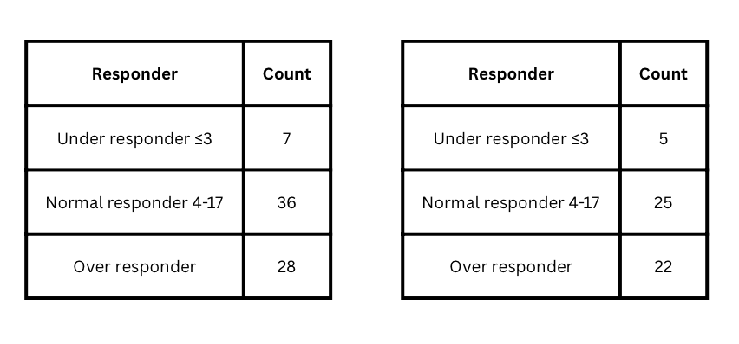
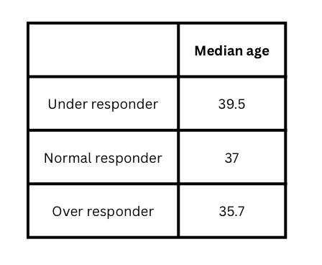
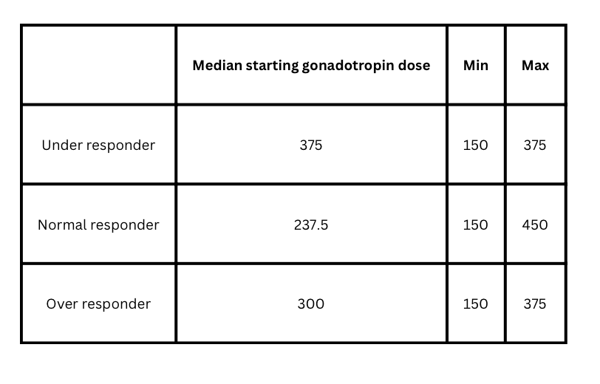
Stratifying by responder and total eggs retrieved
Ages
Without egg donor → n=52
Starting gonadotropin dose by responder
Currently building 2 logistic regression models
Predict low responder vs. not
Predict high responder vs. not

Slide 12
Follicle Size
Using size as a measure of follicular response to gonadotropin stimulation
Follicles grow as they are stimulated
Need to reach certain size before the clinician decides to administer the trigger
Currently in my dataset have the amount of follicles <11.9mm
Interested in amount >11.9mm as those are reaching the optimum target range
Attempted to derive amount of follicles >11.9 by: final total follicles – final <11.9mm
Numbers do not add up
Will bring this up in the meeting
Include size as a predictor of mature oocytes too

Slide 13
Predicting the initial gonadotropin dose
Attempt to deal with structural 0s and maintain the sample size (not make n too small by analyzing separate stimulation protocols)
What are clinicians using to decide what initial dose to give?
Problem: FSH and hMG have different modes of action which are not accounted for → can only be accounted for if stim protocols modelled separately
Models perform weakly
Likely because we are missing baseline FSH, E2
Next step: stratify by age
Separate into age groups: younger/older and keep dose as total gonadotropin dose

